Slide 1
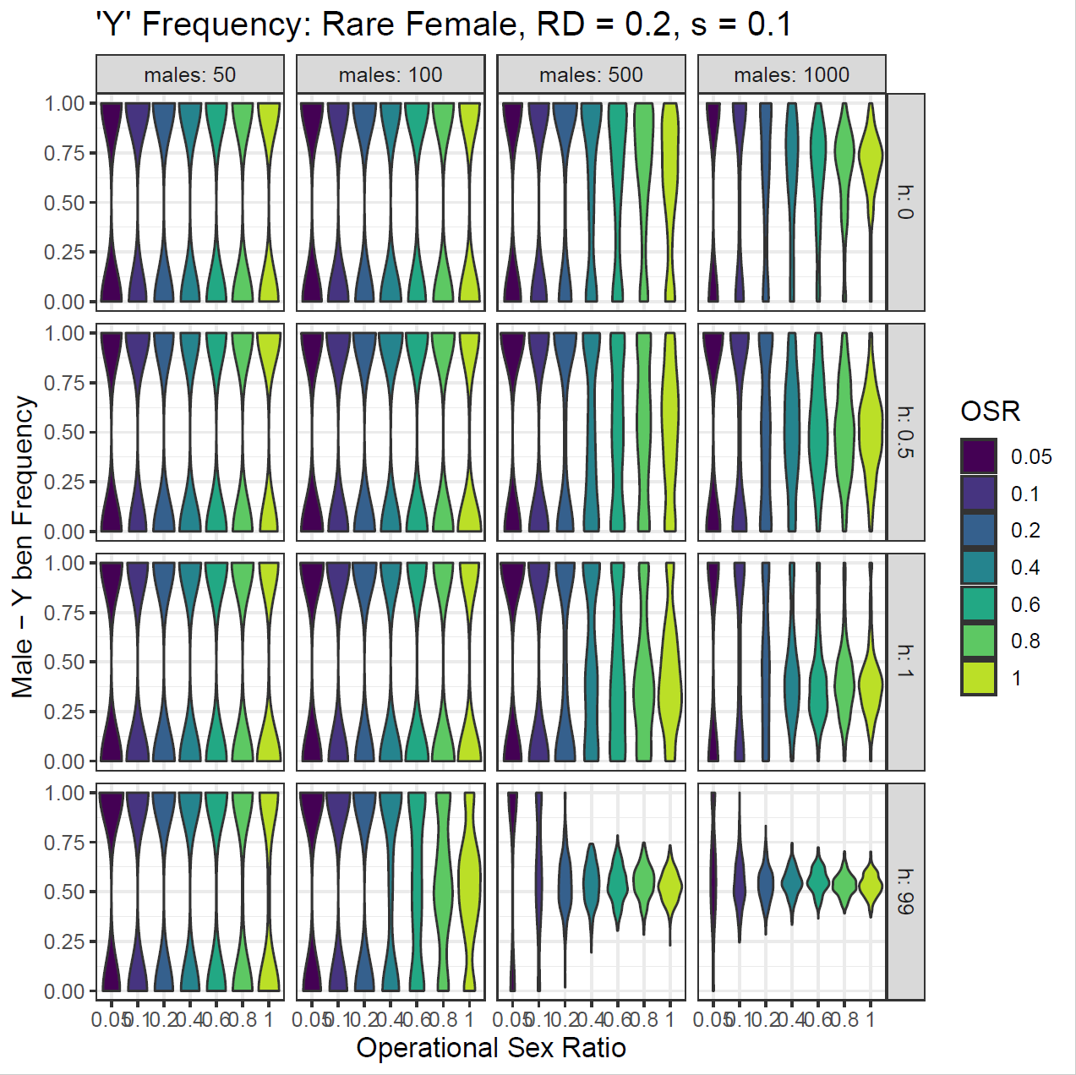
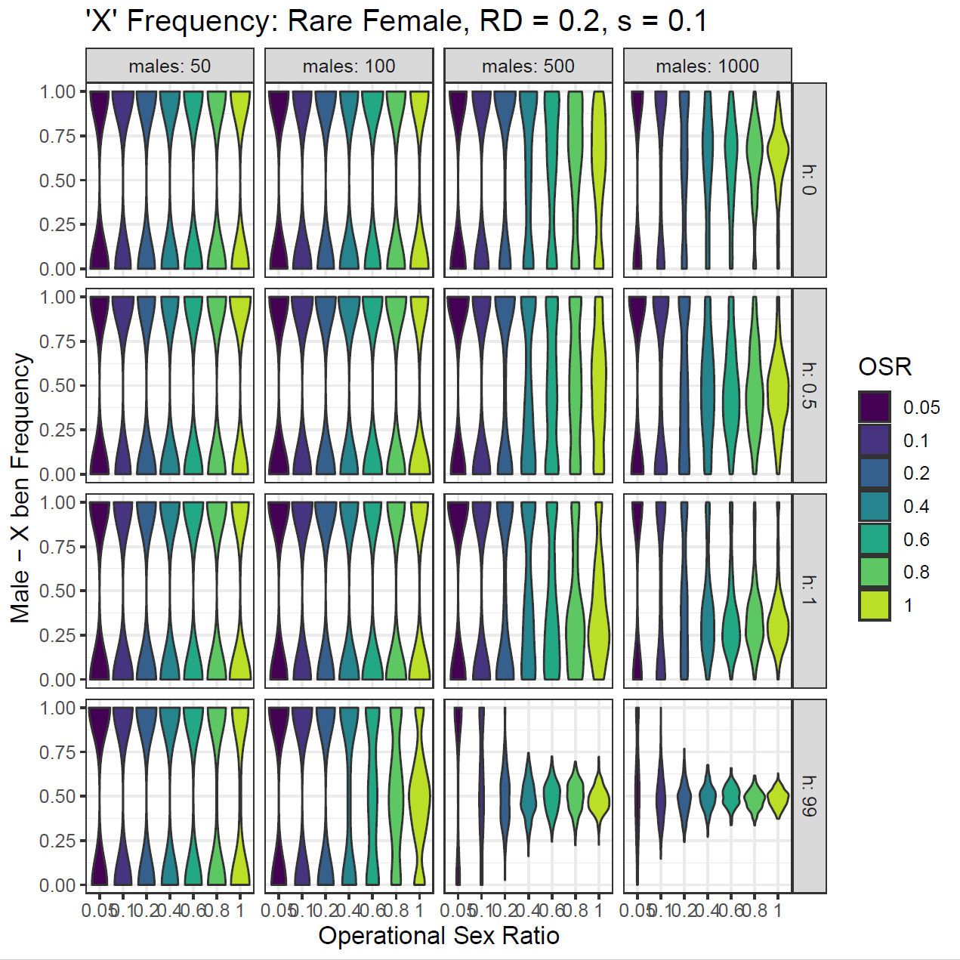
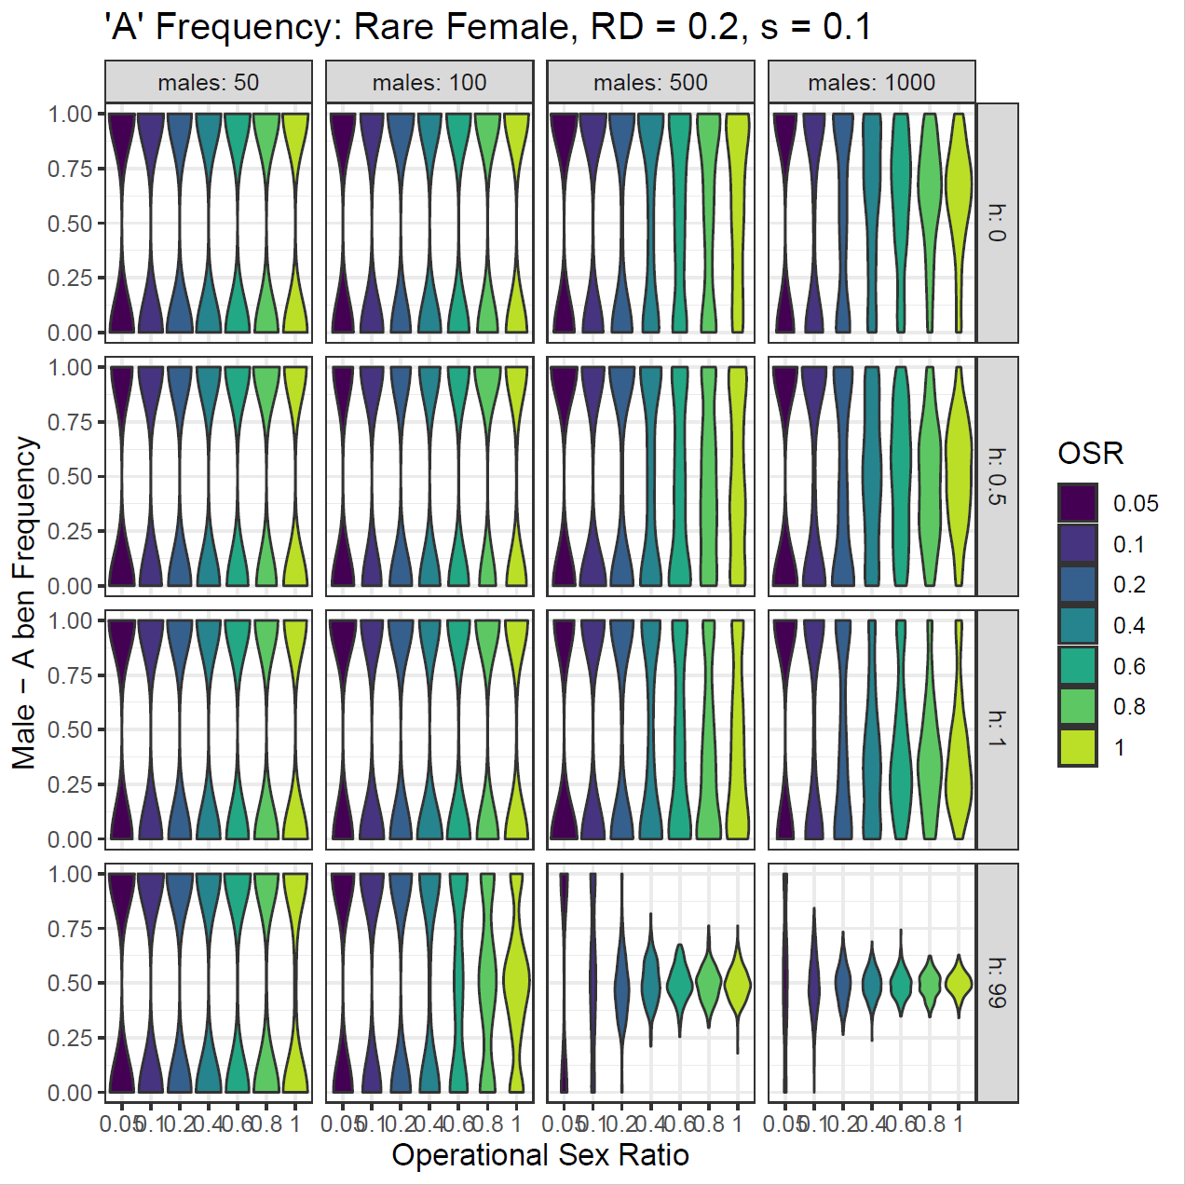
Frequency (Rare Fem, s=0.1)
Drift is the main factor in small populations (50/100), excluding h = 99 (SSD)
In large populations, drift is the main factor at the more extreme OSR levels
At high OSRs, in large populations, selection can be seen to have an effect
When recessive, common ben allele increases
When dominant, common ben allele decrease
By comparison, the sex chromosomes have a stronger selection compared to the Autosome (Anova)
With Males as the common sex, the selection on the Y chromosome is slightly stronger than the X chromosome (t-test)

Slide 2
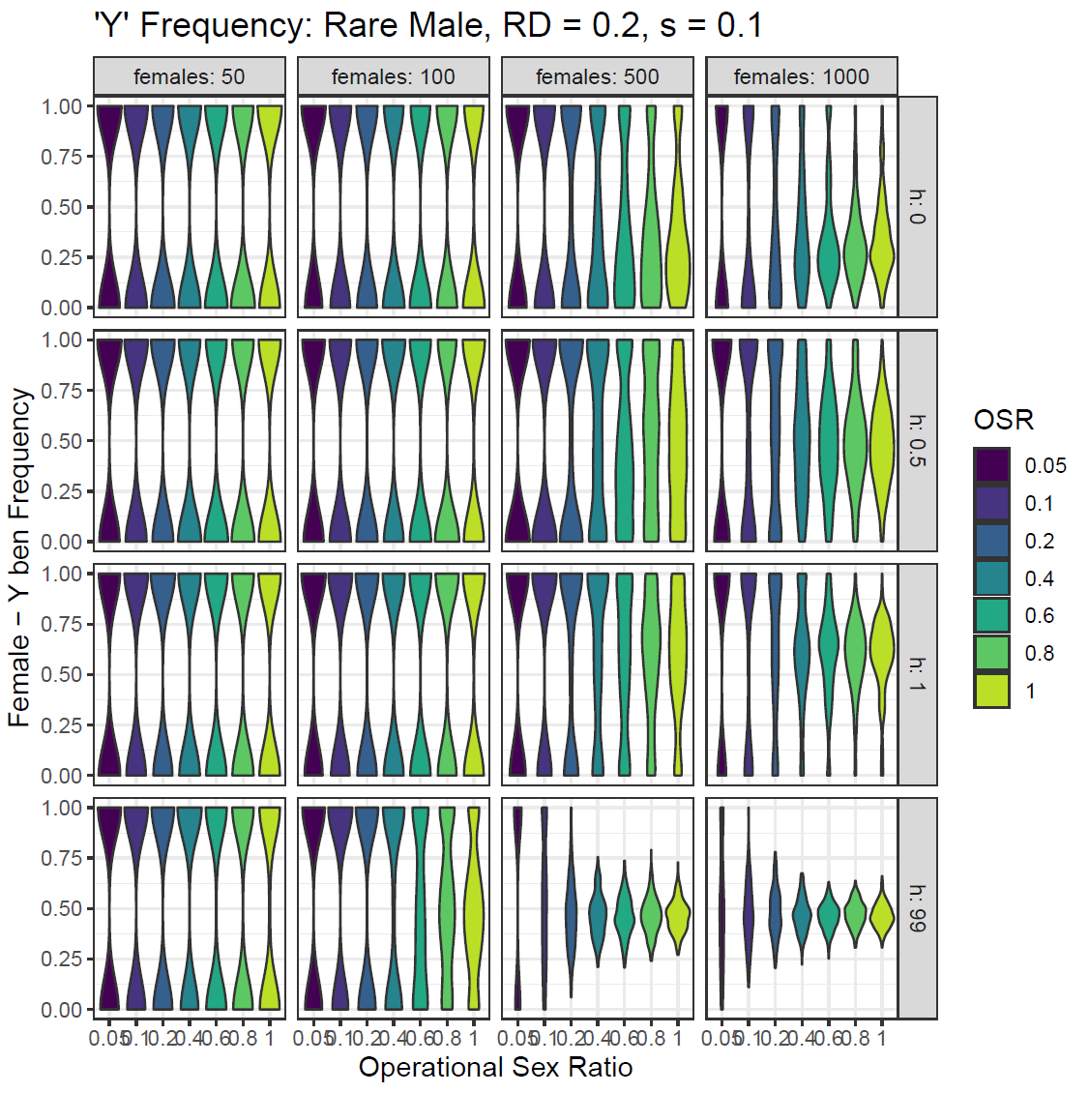
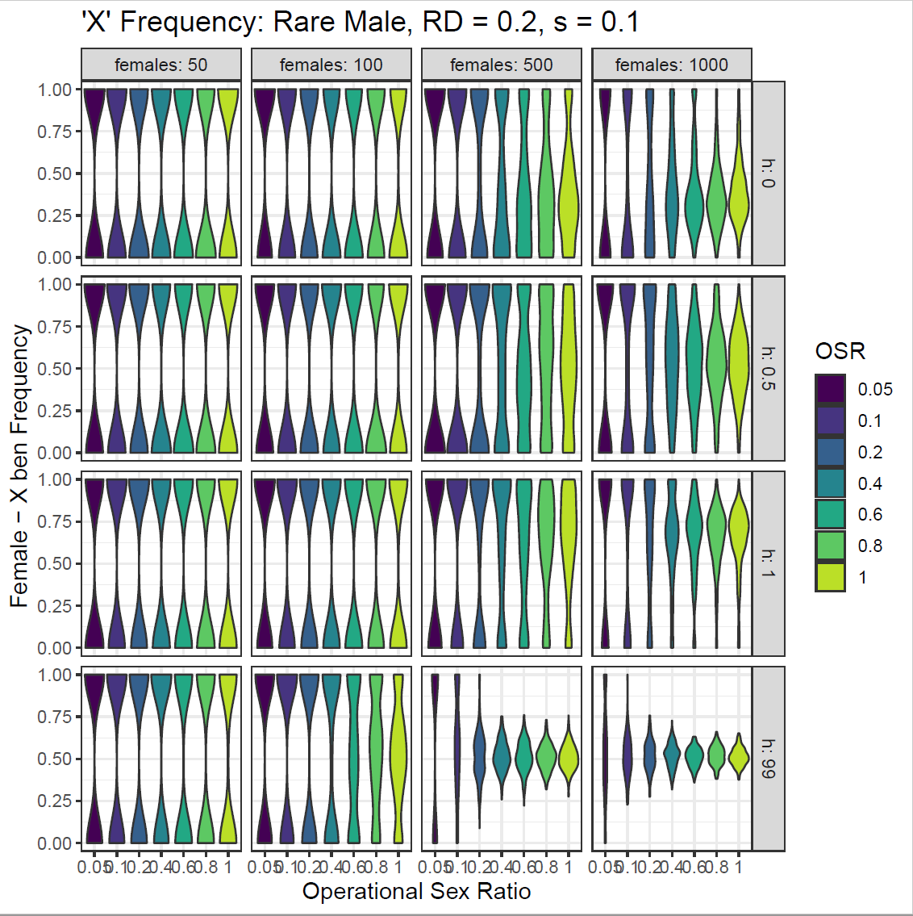
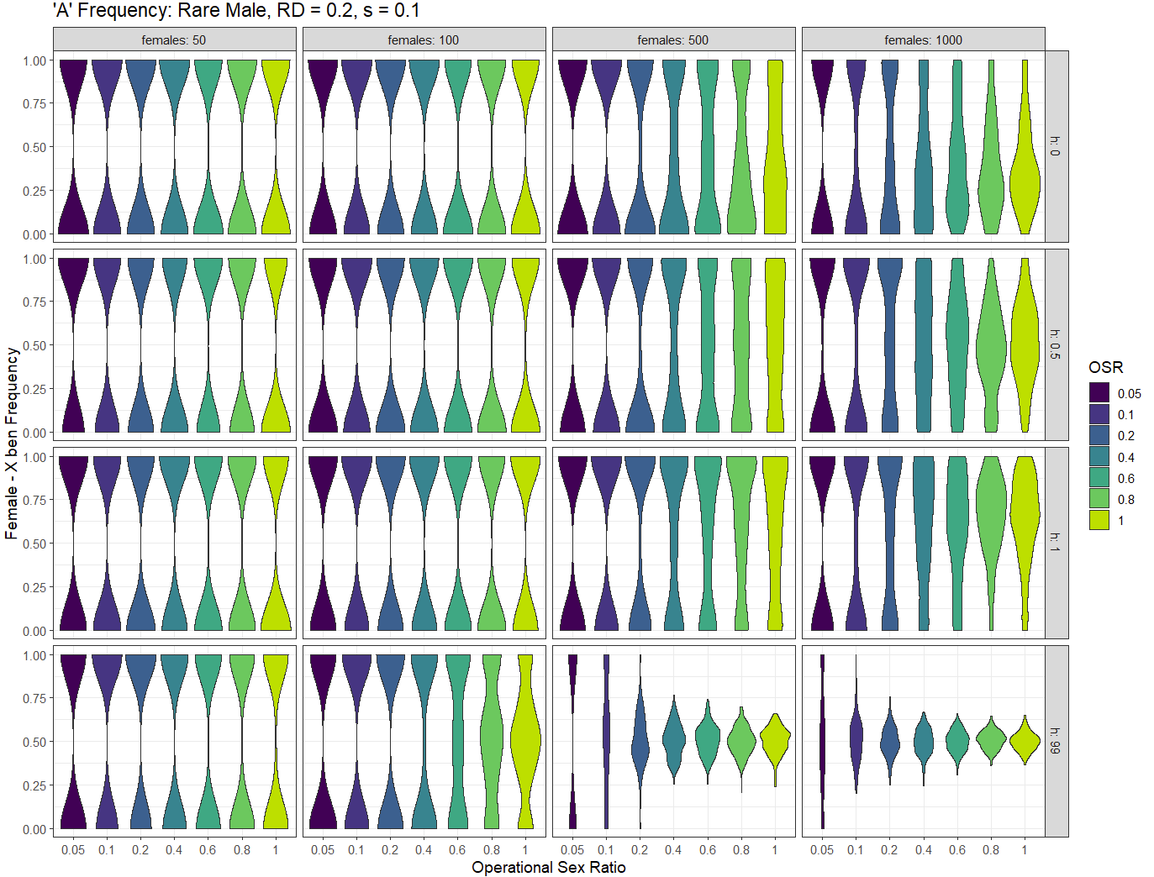
Frequency (Rare Mal, s=0.1)
Reverse of rare female graphs relevant to dominance
Y – With Females as the common sex, the selection for the female ben allele on the Y is only seen by males and the freq is lower compared to the X and A (anova)

Slide 3
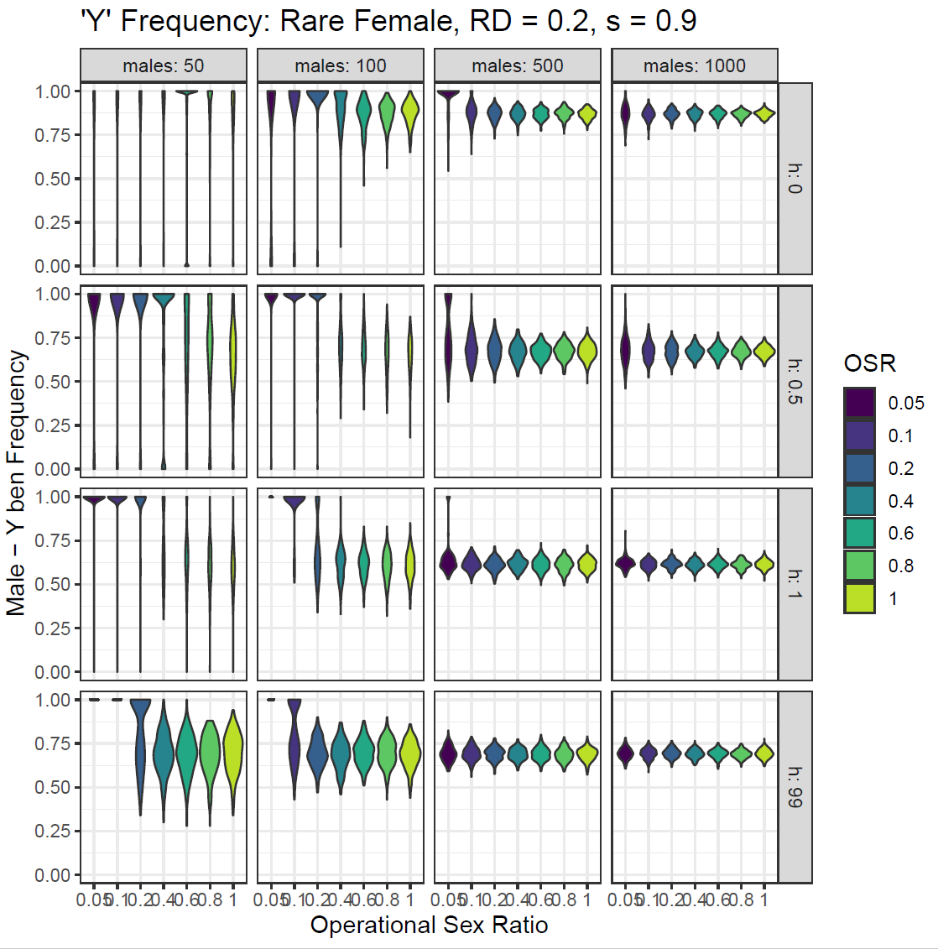
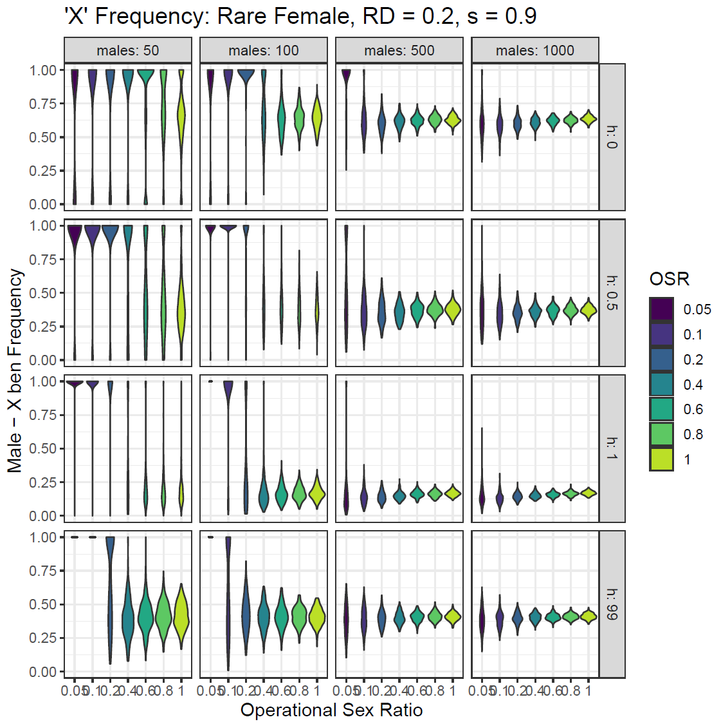
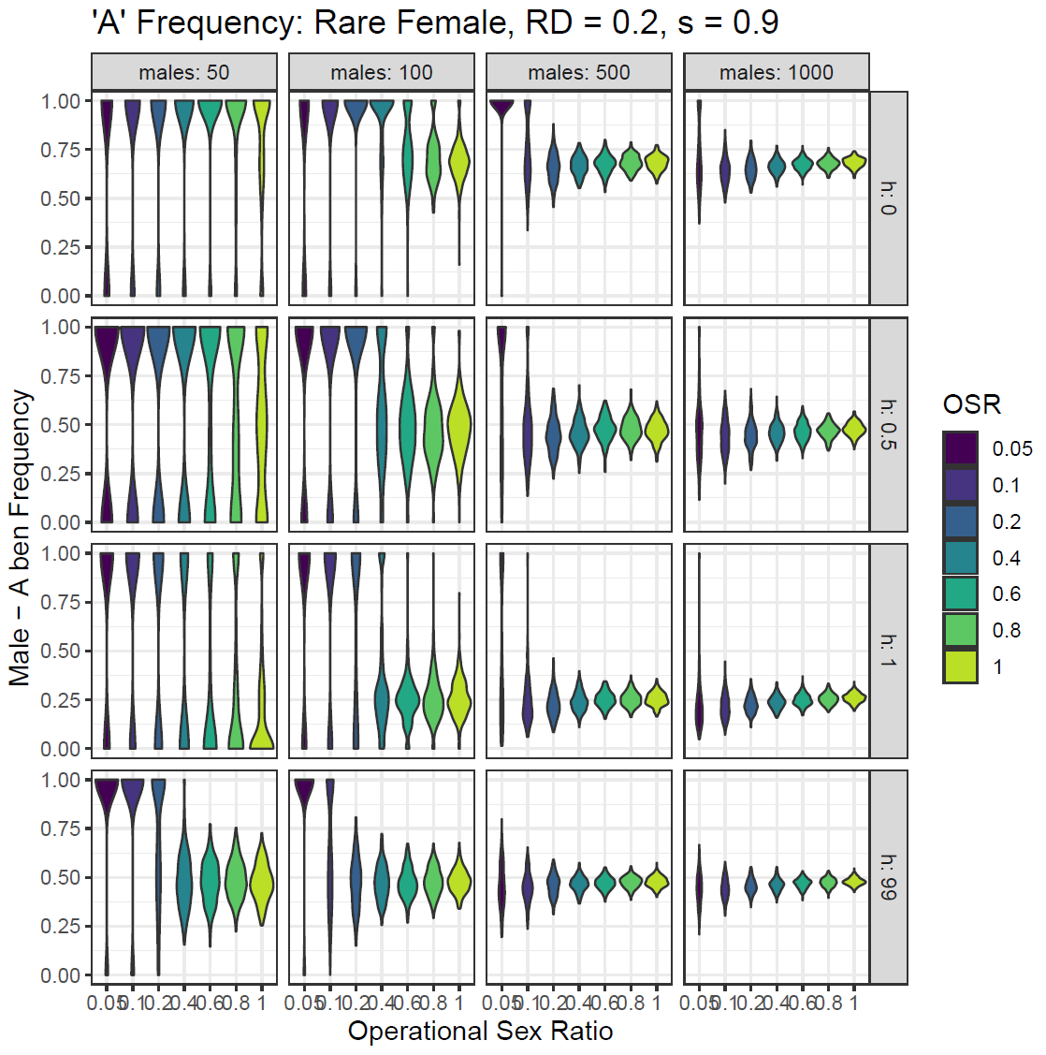
Frequency (Rare Fem, s=0.9)
Drift
Main factor in smaller populations, smaller OSRs, with the common sex allele being selected regardless of necessity
In larger populations, is the main factor at extreme OSR levels
Selection
In smaller populations, higher OSRs, selection begins to take effect
In larger populations, selection is the main factor at most OSRs
Y chromosome – Given that only the male sees the Y chromosome, the ben allele for males increases in all dominance levels, but increases the most in a recessive situation
A chromosome
When recessive, common ben allele increases
When dominant, common ben allele decrease
X – Male only needs one X chr to see effect
additive, slightly decreases
recessive, slightly increases
Dominant, decreases a lot (compared to Auto)

Slide 4
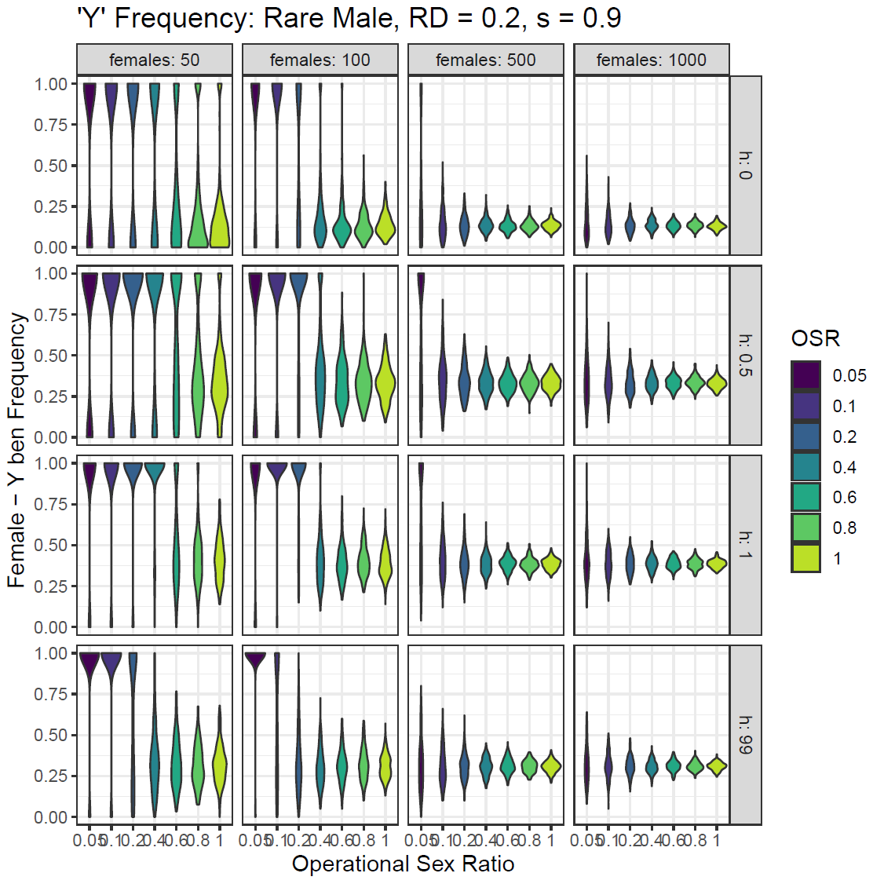
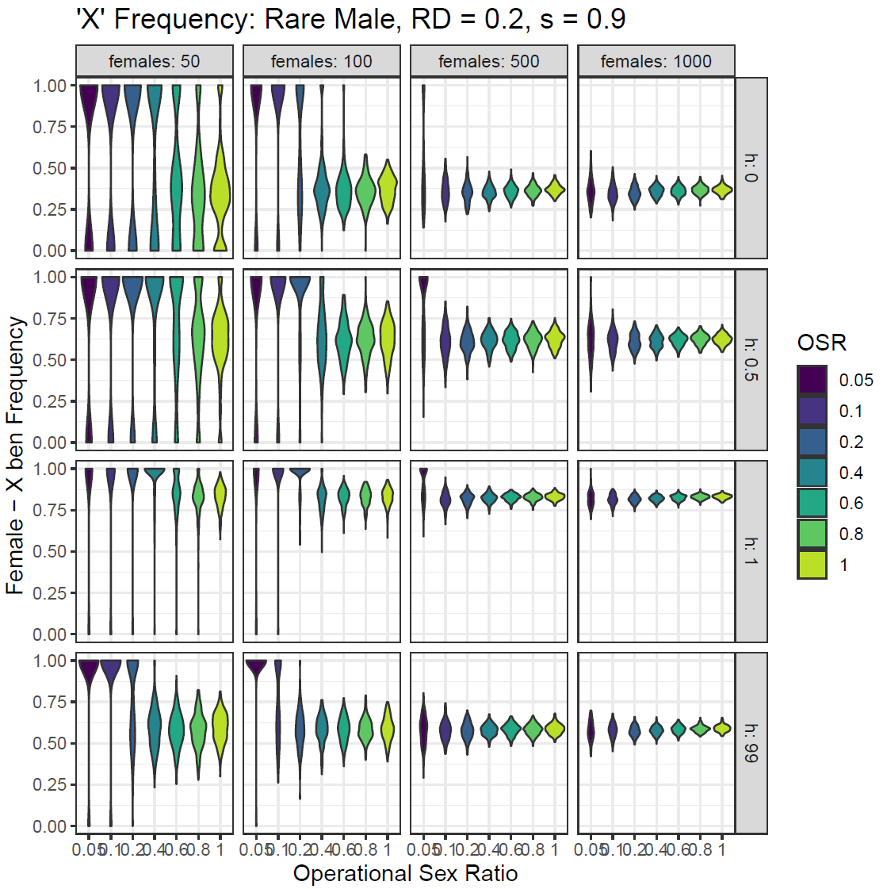
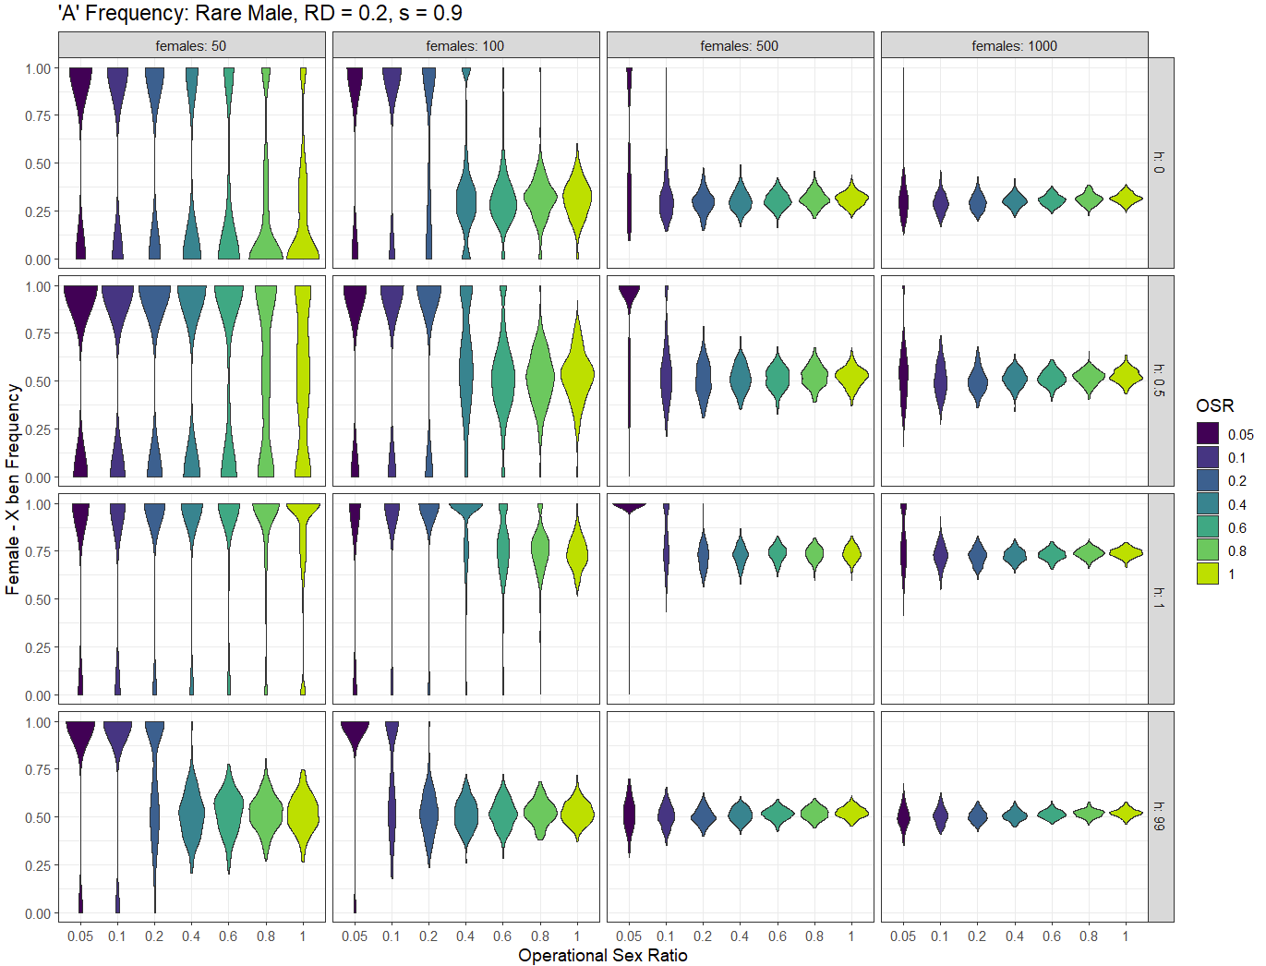
Frequency (Rare Mal, s=0.9)
Drift
Main factor in smaller populations, smaller OSRs, with the common sex allele being selected regardless of necessity
In larger populations, is the main factor at extreme OSR levels
Selection
In smaller populations, higher OSRs, selection begins to take effect
In larger populations, selection is the main factor at most OSRs
Y chromosome – Given that only the male sees the Y chromosome, the ben allele for females (detrimental to males) decreases in all dominance levels, but decreases the most in a dominant situation
A chromosome
When recessive, common ben allele increases
When dominant, common ben allele decrease
X – Female sees 2, males sees 1
Additive, slightly increases so female (common sex) can see the effect more
Recessive, greatly increases
Dominant, slightly decreases

Slide 5
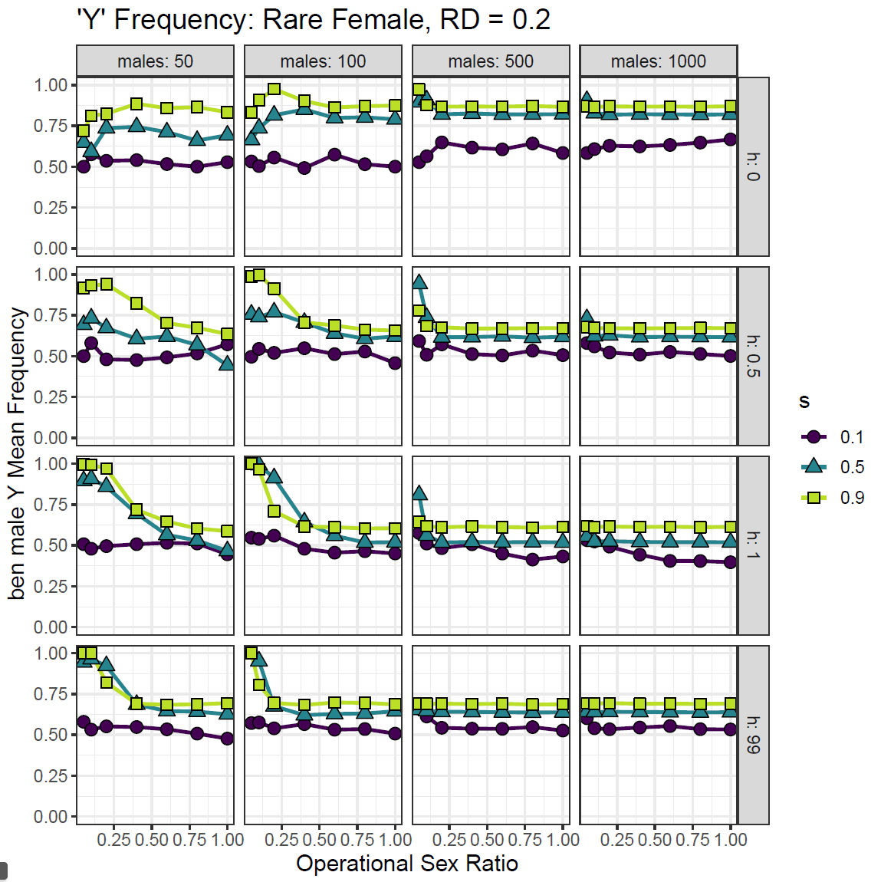
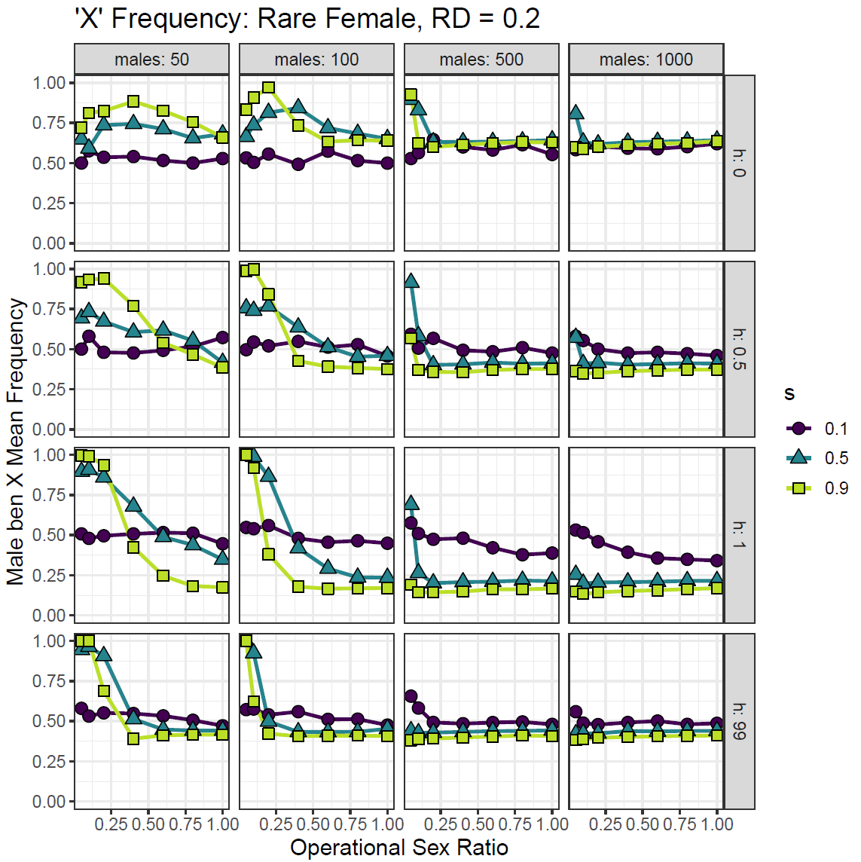
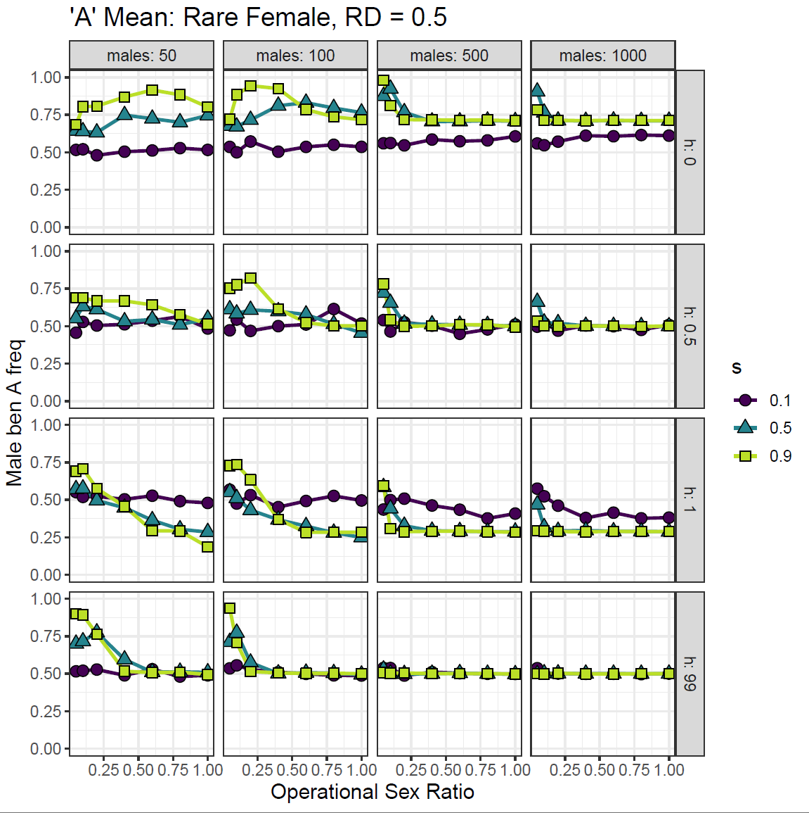
Mean (Rare Fem)
S = 0.9
Y chromosome – Given that only the male sees the Y chromosome, the ben allele for males increases in all dominance levels, but increases the most in a recessive situation
A chromosome
When recessive, common ben allele increases
When dominant, common ben allele decrease
X – Male only needs one X chr to see effect
additive, slightly decreases
recessive, slightly increases
Dominant, decreases a lot (compared to Auto)
s = 1:
mean barley fluctuates unless in large population and high OSR when selection starts to take effect
s = 9:
drift at extreme OSR, especially small pop
Selection in large pop, and small pop high OSR

Slide 6
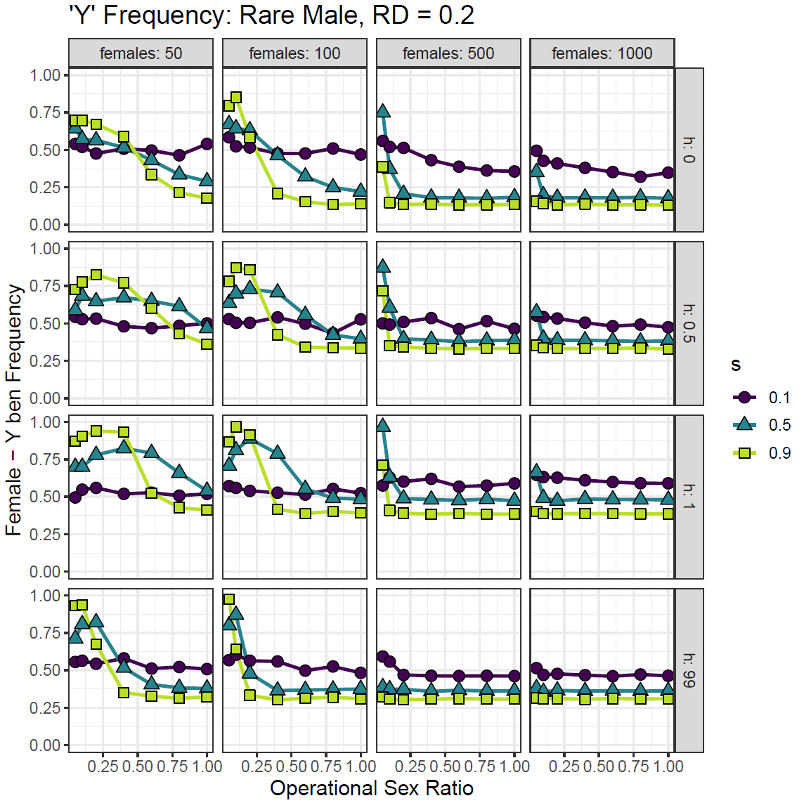
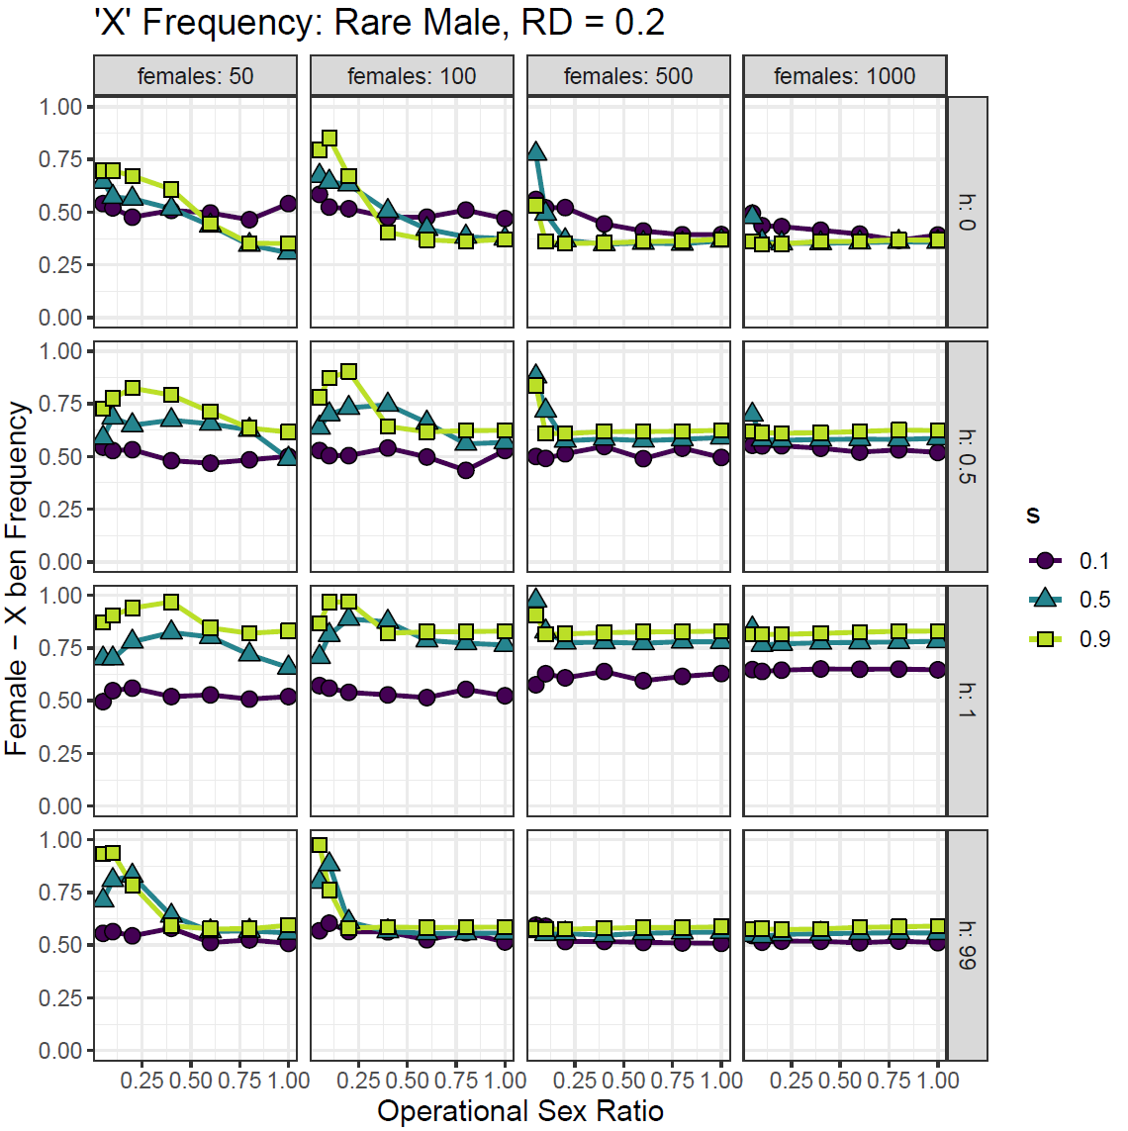
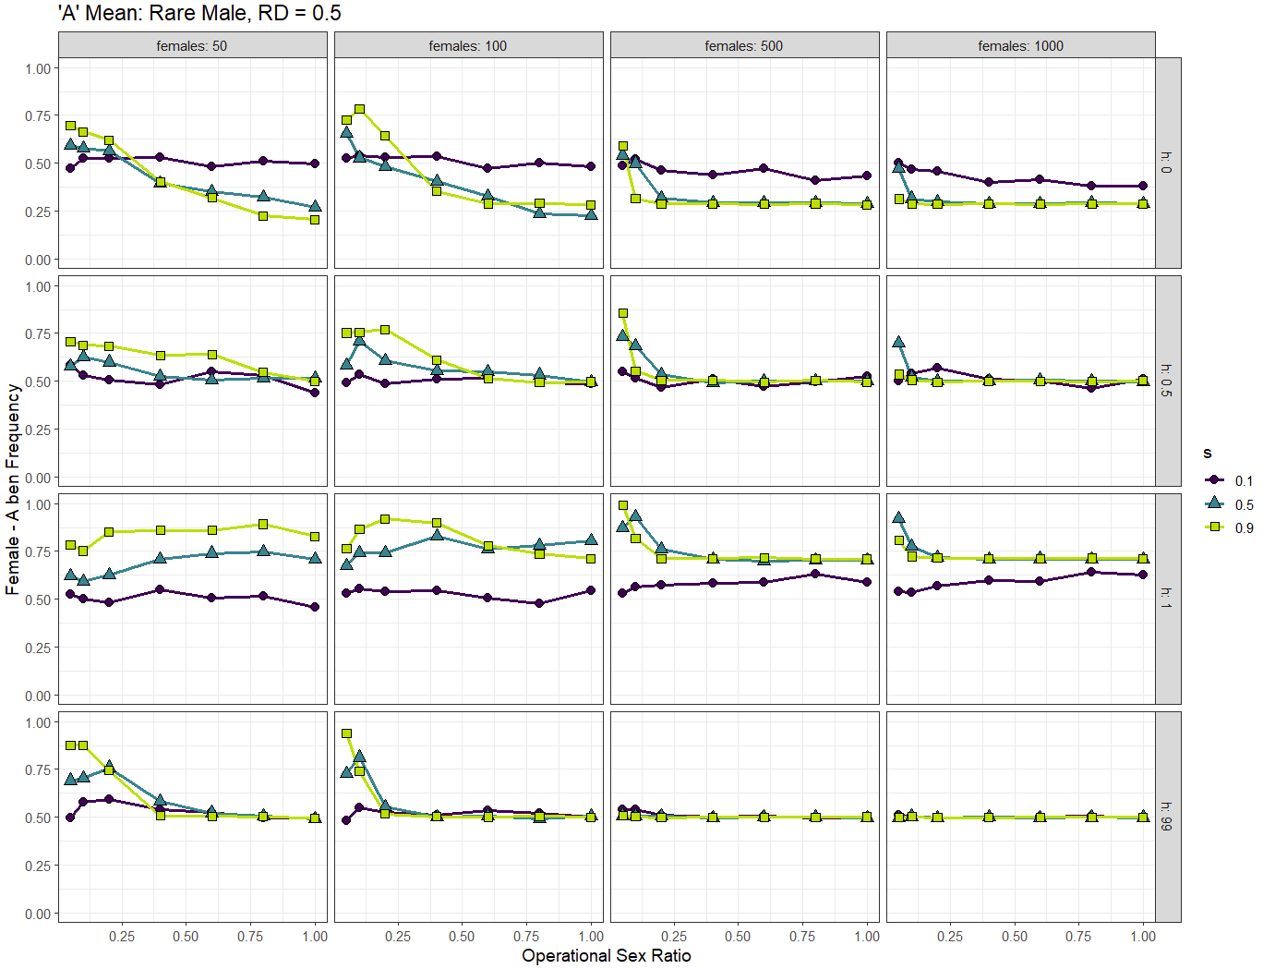
Mean (Rare Mal)
S = 0.9
Y chromosome – Given that only the male sees the Y chromosome, the del allele for males (female ben) decreases in all dominance levels but decreases the most in a recessive situation
A chromosome
When recessive, common ben allele increases
When dominant, common ben allele decrease
X – Female has two X chromosomes
Additive - slightly increases to increase effect
Recessive - greatly increases
Dominant – decreases lightly
s = 1:
mean barley fluctuates unless in large population and high OSR when selection starts to take effect
s = 9:
drift at extreme OSR, especially small pop
Selection in large pop, and small pop high OSR

Slide 7
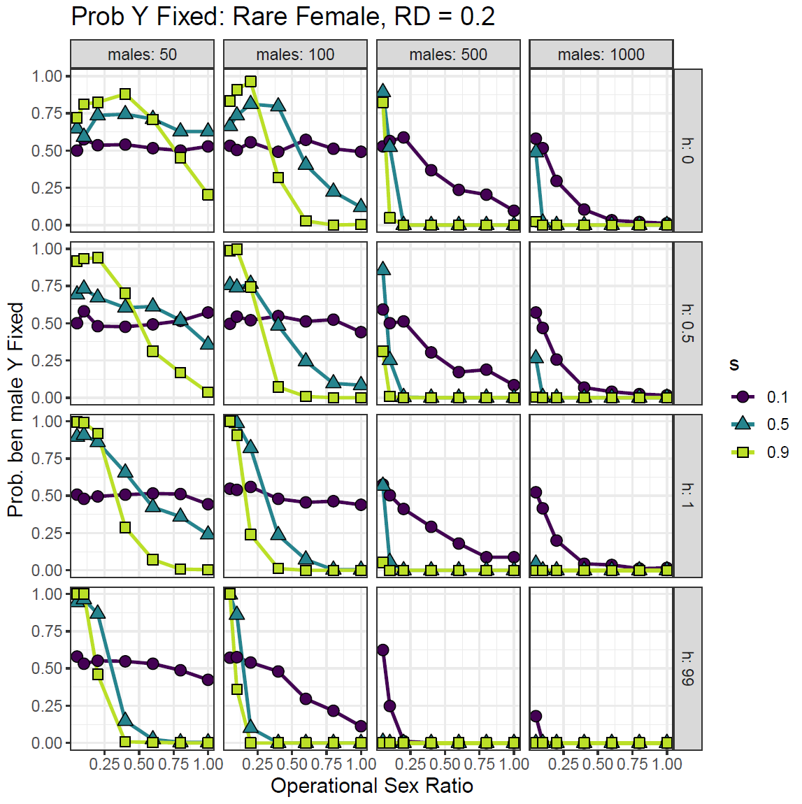
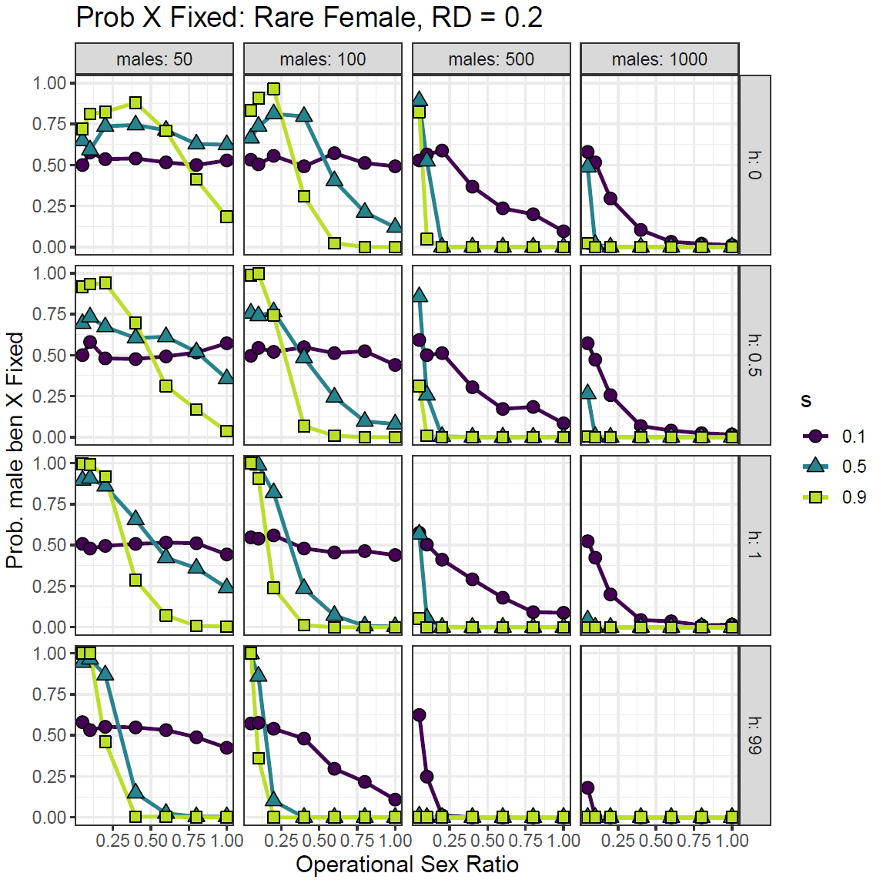
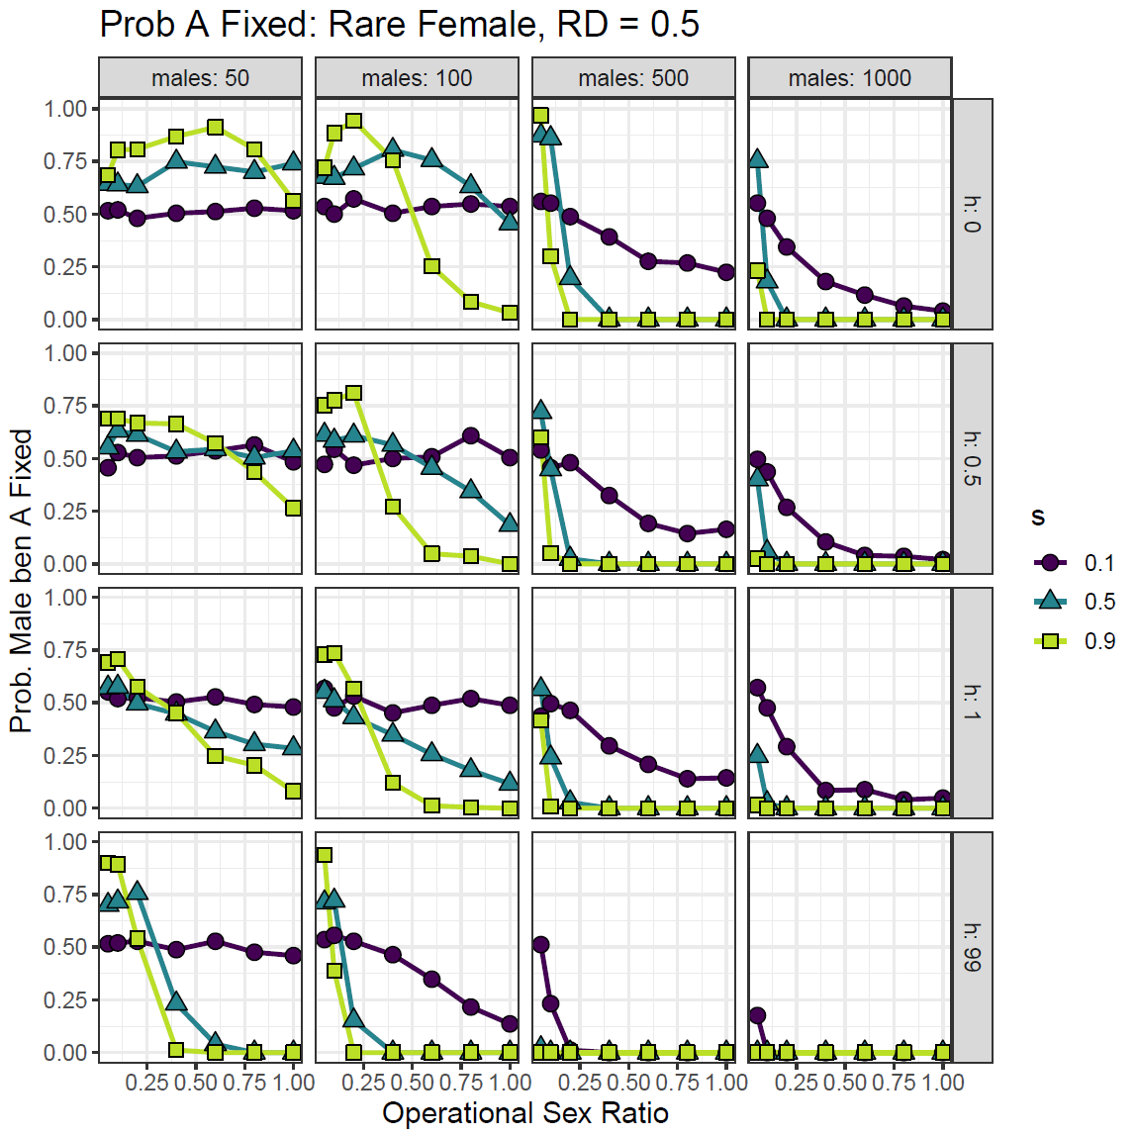
Fixation (Rare Fem)
X/Y almost identical
s = 1:
Small pop – 50% chance of fixation
Large pop, non-extreme OSR, 0% chance of fixation
s = 9:
High chance of fixation at extreme OSR, especially small pop
> 75% at all but one of these instances in all dominance levels
Otherwise, no chance of fixation, especially large pop
Autosome
s = 1:
Small pop – 50% chance of fixation
Large pop, non-extreme OSR, 0% chance of fixation
s = 9:
Higher chance of fixation at extreme OSR, especially small pop
Not as high of a chance compared to Sex Chromosome
Best chance when recessive
Otherwise, no chance of fixation, especially large pop

Slide 8
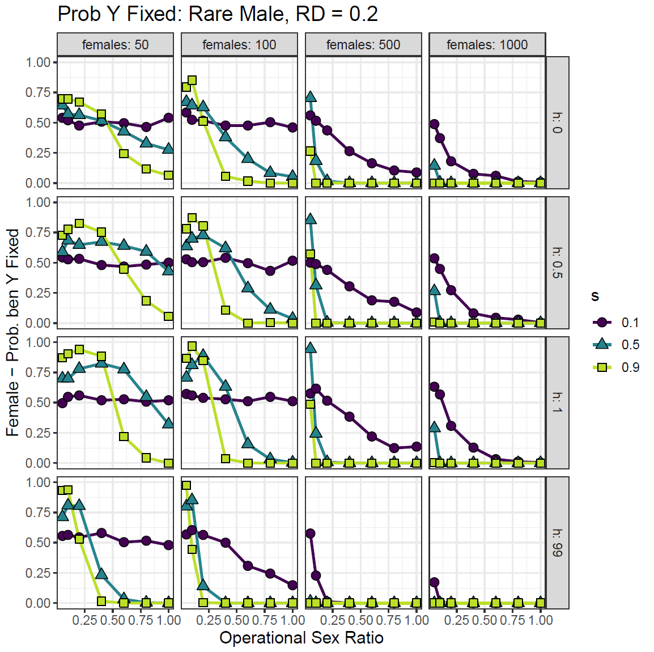
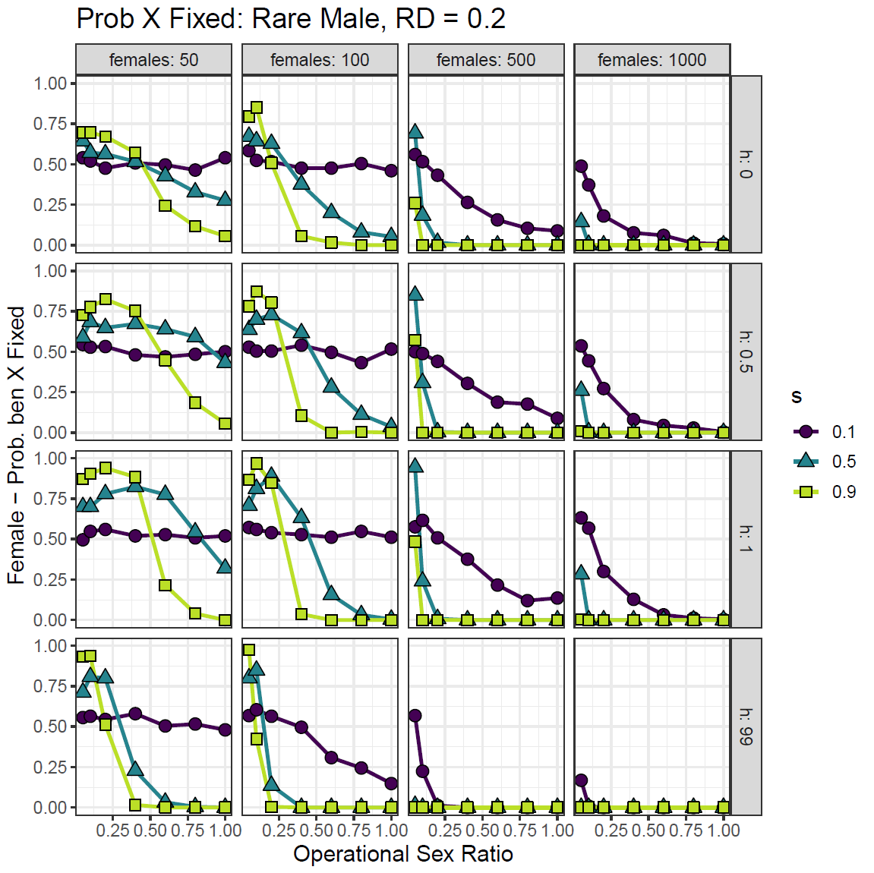
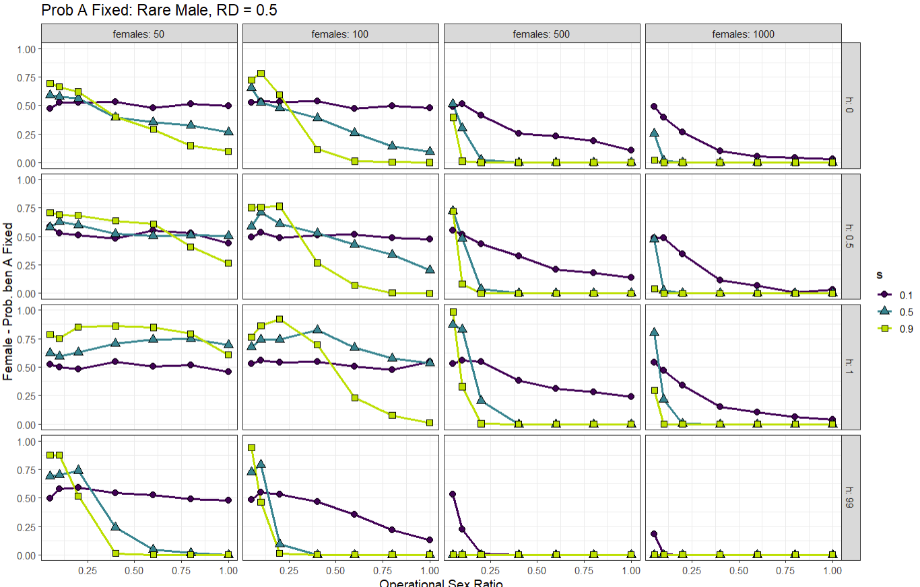
Fixation (Rare Mal)
X/Y almost identical
s = 1:
Small pop – 50% chance of fixation (exc h = 99)
Large pop, non-extreme OSR, very small chance of fixation
s = 9:
Fairly high chance of fixation at extreme OSR, especially small pop
Lower chance compared to rare female graphs
Most >75% of fixation when allele is recessive
Otherwise, no chance of fixation, especially large pop
Autosome - except pop 50, very similar to sex chromosomes
s = 1:
Small pop – 50% chance of fixation
Large pop, non-extreme OSR, 0% chance of fixation
s = 9:
Higher chance of fixation at extreme OSR, especially small pop
Not as high of a chance compared to Sex Chromosome
Best chance when recessive
Otherwise, no chance of fixation, especially large pop

Slide 9
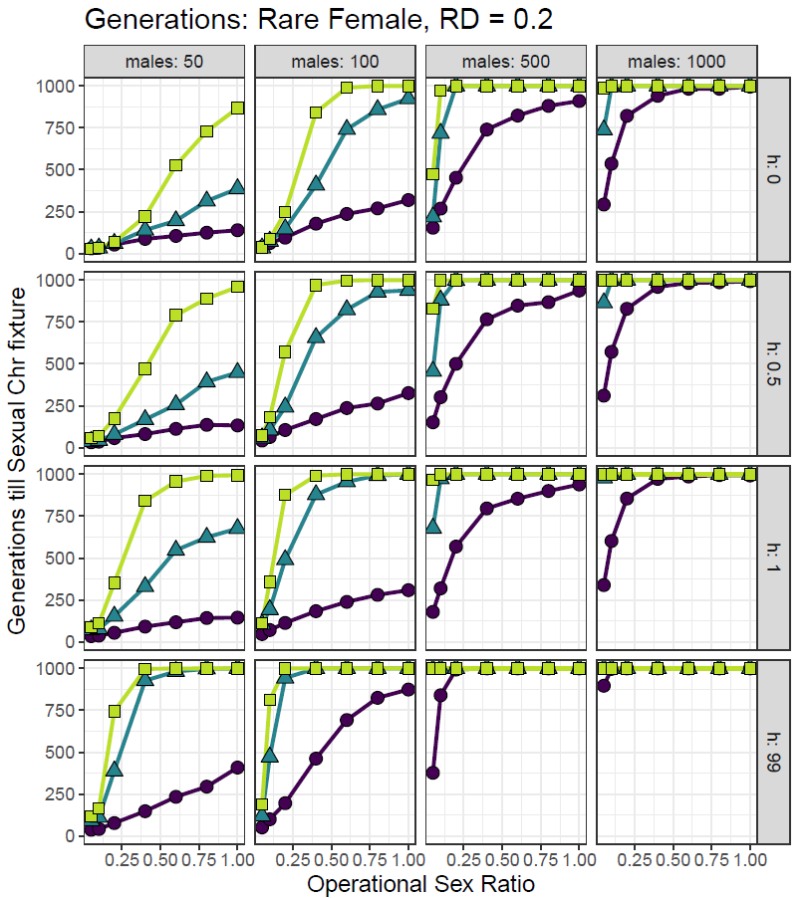
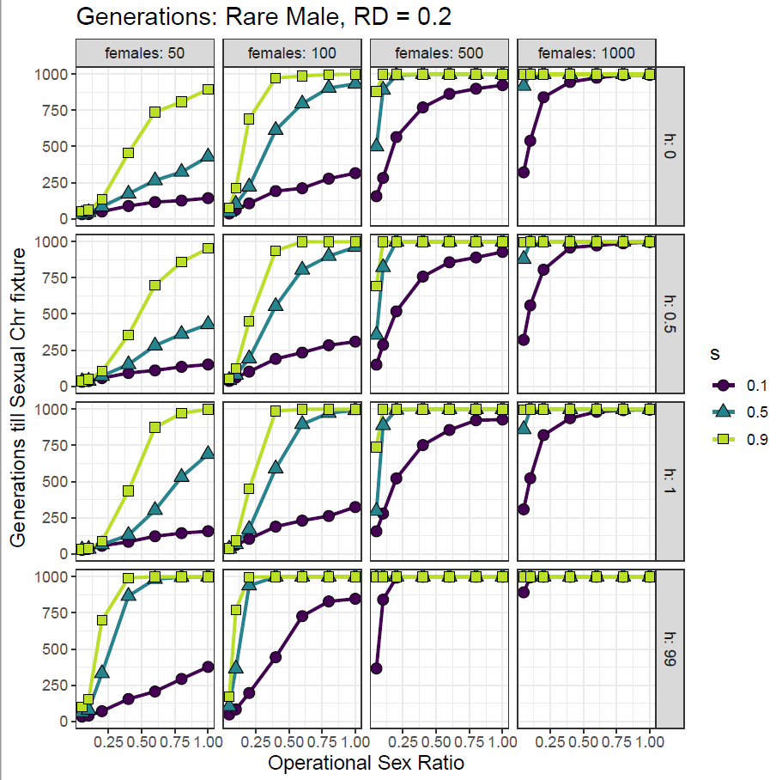
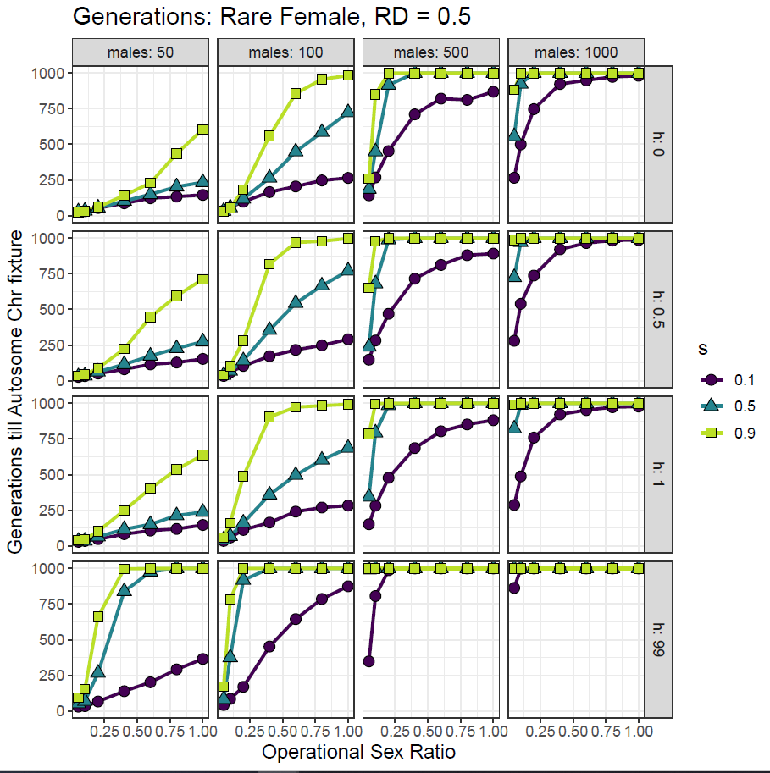
Generations
< 1000 generations to fix
Pop 50: most OSRs
Pop 100: low OSRs
High Pops: Extreme low OSRs or low selection

Slide 10
Largest diff in s = 0.9, h = 1, small populations, any h (50/0) exception
Largest diff in s = 0.9, smaller pop, smaller OSR in general
In both common male and rare female, the largest difference in fitness between sexes can be found in the smaller pop with extreme OSR levels
Largest differences are when the common allele is dominant & extreme OSR
Larger difference when male is common sex (t-test)

Slide 11
Extremely fit common sex with unfit rare sex in small population, extreme OSR, high s
Most fit rare sex also have very fit common sex – in large pop, low s
Appears to be more of a potential larger difference when female is rare

Slide 12
In autosomes, just switch h:0 and 1 and the x/y axis and you'll have the fitness differences for each species. They are equivalent. It just depends on which sex is the common sex.
The common sex is almost always more fit
Biggest fit diff when s = 0.9, h = 0/1, more extreme OSR, <500 pop

